Slide 1

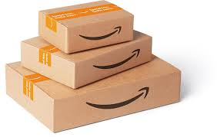
SQL – Project
To gain insights into the sales data of Amazon
Avinash Prasad
S7769

Slide 2
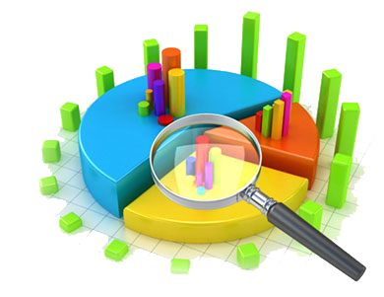
Product Analysis:-
As per Analysis conducted on data,
Fashion Accessories has the highest sales.
Food & Beverages contribute second highest sales and also high average ratings.
Health and Beauty contribute the least among the product.

Slide 3

Sales Analysis:-
The Sales in the month of January was high followed by February and March.
In Weekdays , the revenue is highly generated on Saturday followed by Tuesday.
Most of the orders were placed at Afternoon and few orders were placed in the Morning.

Slide 4

Customer Analysis:-
This Analysis aims to different Segment and Purchase trends of each customer segment,
Most product categories ordered by gender:-
Female - Fashion Accessories
Male - Health & Beauty
Customer type member has generated more revenue and also ordered most number of times.

Slide 5
Recommendation:-
In order to boost the performance and sales of Home & Lifestyle, Sports & Travel and Electronic Accessories there is a need of implementing prioritize marketing effort.
Feature product on homepage, promote daily offers, show new arrivals, promote discounts & sales and ensures product quality.

Slide 6


